Slide 1
Metabolism
Edwin Maiko

Slide 2
What is Metabolism?
Def:
The entire chemical reaction network of the body that are catalysed by enzymes.
The intermediates, substrates or products of these enzyme catalysed reactions are referred to as Metabolites.
The sequence of enzymatic reactions that lead to specific products are referred to as Metabolic Pathways. They are of three types:
Catabolic pathways (Catabolism): Breakdown of complex molecules (Carbohydrates, Proteins & Lipids) to small molecules. Energy is generated.
Anabolic pathways (Anabolism): Synthesis of complex molecules from small molecules. Energy is consumed.
Amphibolic pathways: Act as links between catabolic pathways and anabolic pathways.
Note: These pathways do not occur in isolation.

Slide 3
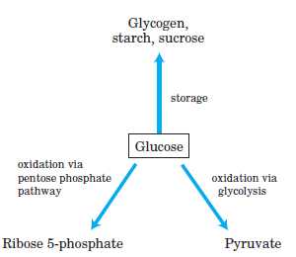
Carbohydrate Metabolism
Glucose occupies a central position in the metabolism of plants, animals and many microorganisms.
      It is relatively rich in potential energy, thus a good fuel.(Complete oxidation to CO₂ and H₂O proceeds with a ∆G value of -2,840 KJ/mol).
      It is a versatile precursor, capable of supplying a huge array of metabolic intermediates for biosynthetic reactions. e.g. E. coli can obtain carbon skeleton for Amino acids, nucleotides, coenzymes, fatty acids or other metabolic intermediates it needs for growth.
In animals and vascular plants, glucose has three major fates:
How is glucose synthesized?
Photosynthetic organisms make glucose by fixing CO2 to trioses, then convert the trioses to glucose.
Non-photosynthetic cells make glucose from simpler three and four-carbon compounds by the process of gluconeogenesis

Slide 4
Content:
Glycolysis.
Fructose metabolism
Galactose metabolism
Gluconeogenesis.
Pentose Phosphate Pathway.
Tricarboxylic acid cycle (TCA cycle).
Electron Transport Chain (Oxidative phosphorylation).

Slide 5
Glycolysis
In glycolysis a molecule of glucose is degraded in a series of enzyme-catalyzed reactions to yield two molecules of the three-carbon compound (pyruvate).
The sequential reactions of glycolysis, conserve the free energy released from glucose in form of ATP and NADH.
Glycolysis is the central pathway of glucose catabolism in most cells some of which solely depend on it as a source of metabolic energy .e.g.
  Mammalian tissues and cell types (erythrocytes, renal medulla, brain and sperm cell .
  Plants tissues that are modified to store starch (potato tubers)
  Most anaerobic microorganisms.
The breakdown of the six-carbon (glucose) into two molecules of the three-carbon pyruvate occurs in ten steps, which are divided in to two phases:
      Preparatory phase
      Pay off phase.
      Note: Glycolytic Enzymes are present in the cytosol of cells.

Slide 6
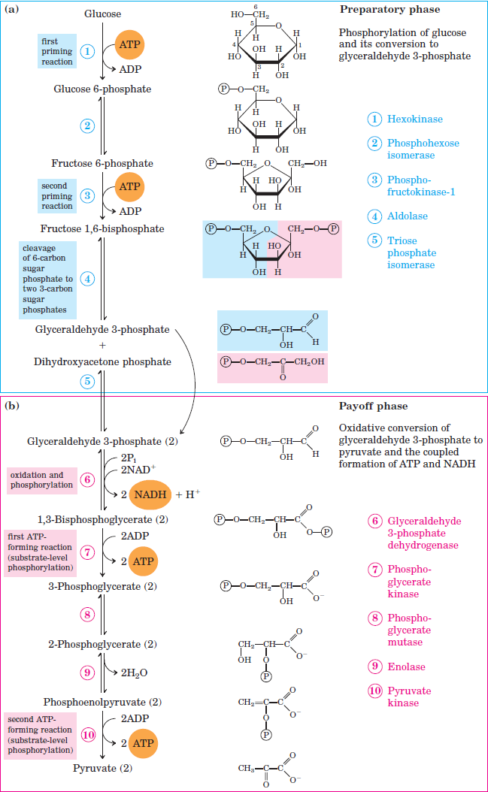
Glycolysis cont….
Preparatory phase
The first five reactions of glycolysis which constitute the preparatory phase the energy of ATP is invested, raising the free-energy content of the intermediates, and the carbon chain of all hexoses are converted into a common product; two molecules of glyceraldehyde 3- phosphate (G3P).
Payoff phase
In the payoff phase of each molecule of G3P is oxidized and phosphorylated by inorganic phosphate (not by ATP) to form 1,3-bisphosphoglycerate.
Energy is then released as the two
molecules of 1,3-bisphosphoglycerate are converted to two molecules of pyruvate.
The net yield is two molecules of ATP and two molecules of NADH per molecule of glucose.

Slide 7
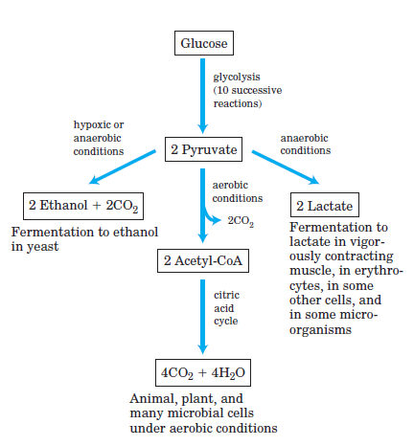
Fates of Pyruvate
The pyruvate formed in glycolysis is further metabolized in three major catabolic routes.
Complete oxidation to CO2 and water in the citric acid cycle and electron transport chain in the mitochondria. The energy from electron-transfer reactions drive ATP synthesis ( e.g. aerobic organisms or tissues).
Pyruvate reduction to lactate via lactic acid fermantation for regeneration of NAD+ required as an electron acceptor for further oxidation of glucose to pyruvate ( e.g. contracting muscle, erythrocytes, retina and anaerobic microorganisms)
Decarboxylation of pyruvate to ethanol in ethanol (alcohol) fermentation under hypoxic or anaerobic conditions (e.g. protists and microorganisms)

Slide 8
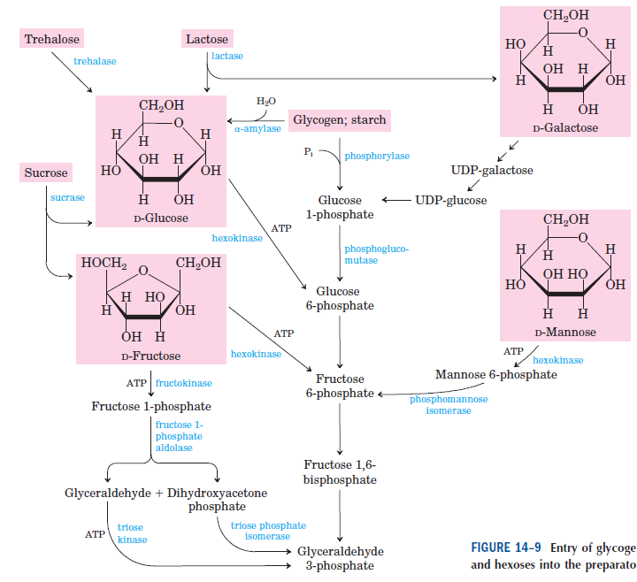
Feeder pathways for Glycolysis

Slide 9
Regulation of Glycolysis
metabolic pathways are regulated by altering activities of few enzymes of that pathway.
Hexokinase, phosphofructo kinase and pyruvate kinase are the regulatory enzymes of glycolysis.
Their activities are under allosteric and hormonal control.
Allosteric regulation of glycolysis
Phosphofructokinase-1:
is the major regulatory enzymes of glycolysis.
It is an allosteric enzyme and catalyzes rate limiting reaction of glycolysis.
It is inhibited by ATP and citrate, while AMP and fructose-6-phosphate are activators of this enzyme.
Pyruvate kinase:
is the second regulatory enzyme.
It is inhibited by ATP.
Hexokinase:
Is inhibited bt Glucose-6-phosphate.
So, when ATP (energy) concentration is highglycolysis is inhibited.
and decrease in ATP level increases rate of glycolysis.

Slide 10
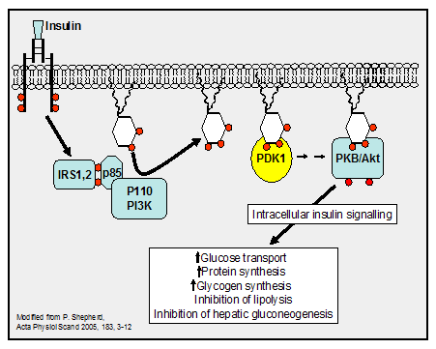
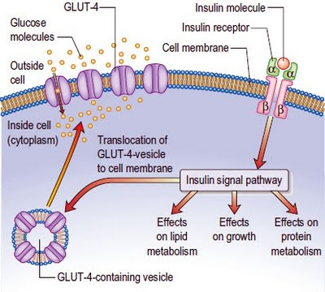
Regulation of Glycolysis cont…
Hormonal regulation of glycolysis
Insulin increases rate of glycolysis by increasing concentration of glucokinase, phosphofructokinase-1 and pyruvate kinase.
Mechanism of Insulin Action

Slide 11
FRUCTOSE METABOLISM
Fructolysis is the term used to refer to the metabolism of fructose from dietary sources.
Though the metabolism of glucose through glycolysis uses many of the same enzymes and intermediate structures as those in fructolysis, the two sugars have very different metabolic fates in human metabolism.
Unlike glucose, which is directly metabolized widely in the body, fructose is almost entirely metabolized in the liver in humans, where it is directed toward replenishment of liver glycogen and triglyceride synthesis.
Under 1% of ingested fructose is directly converted to plasma triglyceride.
Approx. 29% - 54% of fructose is converted in liver to glucose, and about a quarter of fructose is converted to lactate. 15% - 18% is converted to glycogen.
Glucose and lactate are then used normally as energy to fuel cells body

Slide 12
Reactions of Fructose Metabolism.
Fructose is phosphorylated to fructose-1-phosphate by fructokinase in the liver. This enzyme will not phosphorylate glucose and unlike glucokinase its activity is not affected by fasting or by insulin and that is why fructose disappears from the blood of diabetic patients at a normal rate.
•Fructose-1-phosphosphate is cleaved by liver aldolase(aldolase B)to dihydroxy acetone phosphate(DHAP) and D-glyceraldehyde. Aldolase-B also functions in glycolysis in the liver attacking fructose-1,6-bisphosphate.
•D-glyceraldehyde is phosphorylated by glyceraldehyde kinase to D-glyceraldehyde-3-phophate.These two triose phosphates(DHAP and glyceraldehyde-3-phosphate) then may enter the glycolytic pathway, gluconeogenesis or glycogenesis according to the metabolic status of the tissue.
•In extra hepatic tissues, especially the adipose and muscle tissues, fructose can be phosphorylated by hexokinase to fructose-6-phosphate.This however is a slow reaction and occurs only in the presence of high concentration of fructose because when fructose is present with glucose, its phosphorylation is inhibited by glucose.

Slide 13
Continuation.
about a quarter of fructose is converted to lactate. 15% - 18% is converted to glycogen.
Glucose and lactate are then used normally as energy to fuel cells all over the body.
Fructose is a dietary monosaccharide present naturally in fruits and vegetables, either as free fructose or as part of the disaccharide sucrose, and as its polymer inulin.
It is also present in the form of refined sugars including granulated sugars (white crystalline table sugar, brown sugar, confectioner's sugar, and turbinado sugar), refined crystalline fructose , as high fructose corn syrups as well as in honey.

Slide 14
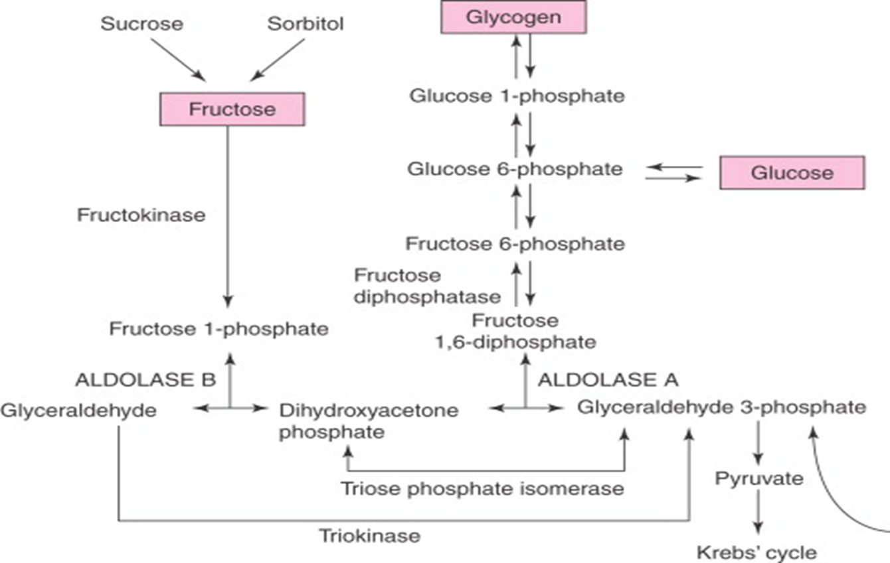
Illustration of the fructose metabolism pathway

Slide 15
Sorbitol or Polyol Pathway for Formation of Fructose
Sorbitol
Sorbitol less commonly known as glucitol, is a sugar alcohol with a sweet taste which the human body metabolizes slowly.
It can be obtained by reduction of glucose, which changes the converted aldehyde group (−CHO) to a primary alcohol group (−C(OH)H2).
Most sorbitol is made from potato starch, but it is also found in nature, for example in apples, pears, peaches, and prunes.
It is converted to fructose by sorbitol dehydrogenase.

Slide 16
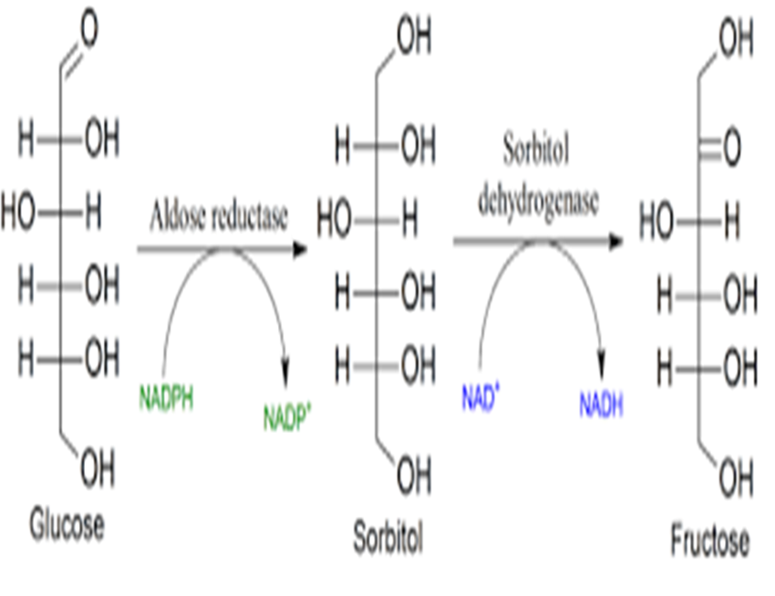
Continuation

Slide 17
Continuation.
The sorbitol (polyol)pathway is for formation of fructose from glucose.
Aldose reductase reduces glucose to sorbitol(glucitol).
It’s found in many tissues such as lens, retina, peripheral nerve cells, kidney, placenta,red blood cells, ovaries and seminal vesicles. But it is not present in liver.
A second enzyme, sorbitol dehydrogenase that can oxidize the sorbitol to fructose is present in liver, ovaries and sperm cell.
In liver, ovaries and sperm cells, the same enzyme, sorbitol dehydrogenase oxidizes the sorbitol to fructose.
The pathway from sorbitol to fructose in the liver provides a mechanism by which dietary sorbitol is converted into fructose which can enter glycolysis.

Slide 18
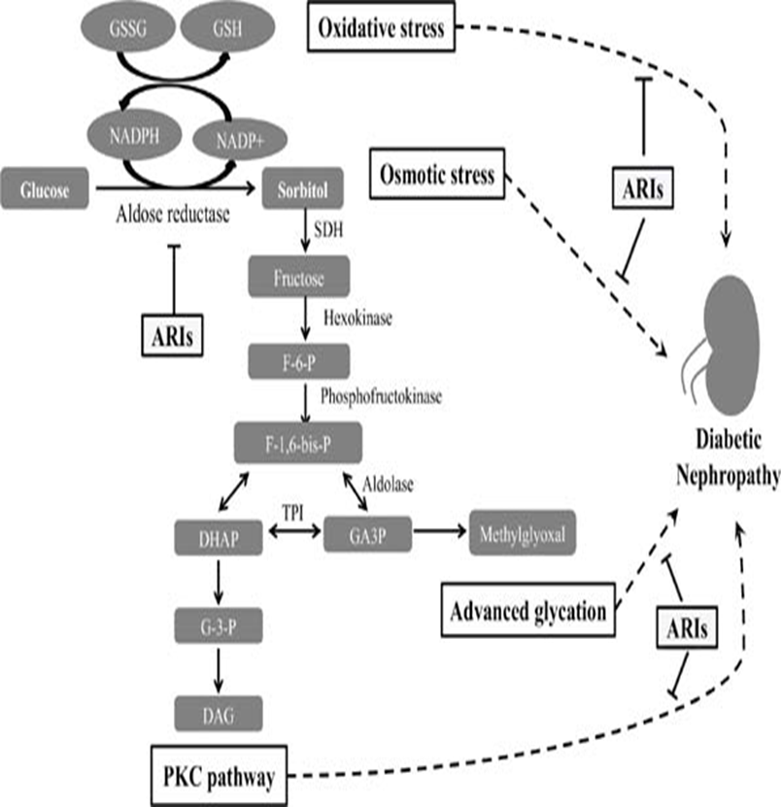
Continuation

Slide 19
Inborn errors in fructose metabolism
1.Essential fructosuria
The absence of fructokinase results in the inability to phosphorylate fructose to fructose-1-phosphate within the cell.
As a result, fructose is neither trapped within the cell nor directed toward its metabolism.
Free fructose concentrations in the liver increase and fructose is free to leave the cell and enter plasma.
This results in an increase in plasma concentration of fructose, eventually exceeding the kidneys' threshold for fructose reabsorption resulting in the appearance of fructose in the urine.
Essential fructosuria is a benign asymptomatic condition.

Slide 20
2.Hereditary fructose intolerance
The absence of fructose-1-phosphate aldolase (aldolase B) results in the accumulation of fructose 1 phosphate in hepatocytes, kidney and small intestines.
An accumulation of fructose-1-phosphate following fructose ingestion inhibits glycogenolysis (breakdown of glycogen) and gluconeogenesis, resulting in severe hypoglycemia.
It is symptomatic resulting in severe hypoglycemia, abdominal pain, vomiting, hemorrhage, jaundice, hepatomegaly, and hyperuricemia eventually leading to liver and/or kidney failure and death.

Slide 21
3.Reduced phosphorylation potential
Intravenous (i.v) infusion of fructose has been shown to lower phosphorylation potential in liver cells by trapping Pi(inorganic phosphate) as fructose 1-phosphate.
The fructokinase reaction occurs quite rapidly in hepatocytes trapping fructose in cells by phosphorylation. On the other hand, the splitting of fructose-1-phosphate to DHAP and glyceraldehyde by Aldolase B is relatively slow.
Therefore, fructose-1-phosphate accumulates with the corresponding reduction of intracellular Pi available for phosphorylation reactions in the cell.
This is why fructose is contraindicated for total parenteral nutrition (TPN) solutions and is never given intravenously as a source of carbohydrate.
It has been suggested that excessive dietary intake of fructose may also result in reduced phosphorylation potential. However, this is still a contentious issue. Dietary fructose is not well absorbed and increased dietary intake often results in malabsorption.

Slide 22
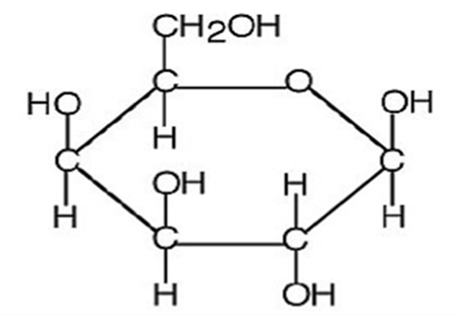
GALACTOSE METABOLISM
Galactose, sometimes abbreviated Gal, is a monosaccharide and the C4 epimer of glucose, that is, they differ only for the position of the -OH group on C4 .It has the molecular formula C6H12O6 and molar mass 180.156 g/mol. It has a sweetness equal to 33% of sucrose.
          Structure of galactose

Slide 23
Food sources of galactose
In human nutrition the most part comes from the hydrolysis of the disaccharide lactose(Galactose + Glucose),the milk sugar, including that of the human milk.
As mother’s milk is the only source of energy and carbohydrates for newborn, galactose has a crucial role in human nutrition.
The monosaccharide is also bound to caseins, and therefore it is found in all dairy products.
Findings from studies conducted since the 50s of last century have shown that galactose is present not only in milk and dairy products, but also in plant products such as legumes, grains, nuts, tubers and vegetables. It seems that in these foods it is often engaged in bonds resistant to the attack of human digestive enzymes, and therefore not metabolizable. However, different fruits and vegetables contain it also in free form, in variable amounts;
Less than 0.1 mg/100 g of edible portion: artichokes, mushrooms, olives, and peanuts; more than 10 mg/100 g of edible portion: bell peppers, date, papaya, watermelon, tomato;
up to 35.4 mg/100 g of edible portion in persimmon.
These values are very low, but to take into account in case of galactosemia

Slide 24
Process of Galactose Metabolism.
Galactose, which is metabolized from the milk sugar, lactose (a disaccharide of glucose and galactose),enters glycolysis by its conversion to glucose-1-phosphate (G-1-P). This occurs through a series of steps that is referred to as the Leloir pathway, named after Luis Federico Leloir who determined the overall process of galactose utilization.
Galactose can exist in two different stereoisomeric forms; α-D-galactose and β-D-galactose. The α-D-form is that which is metabolized in the Leloir pathway.
Conversion of the β-form of galactose to the α-form requires the enzyme galactose mutarotase encoded by the GALM gene (also known as aldose 1-epimerase)

Slide 25
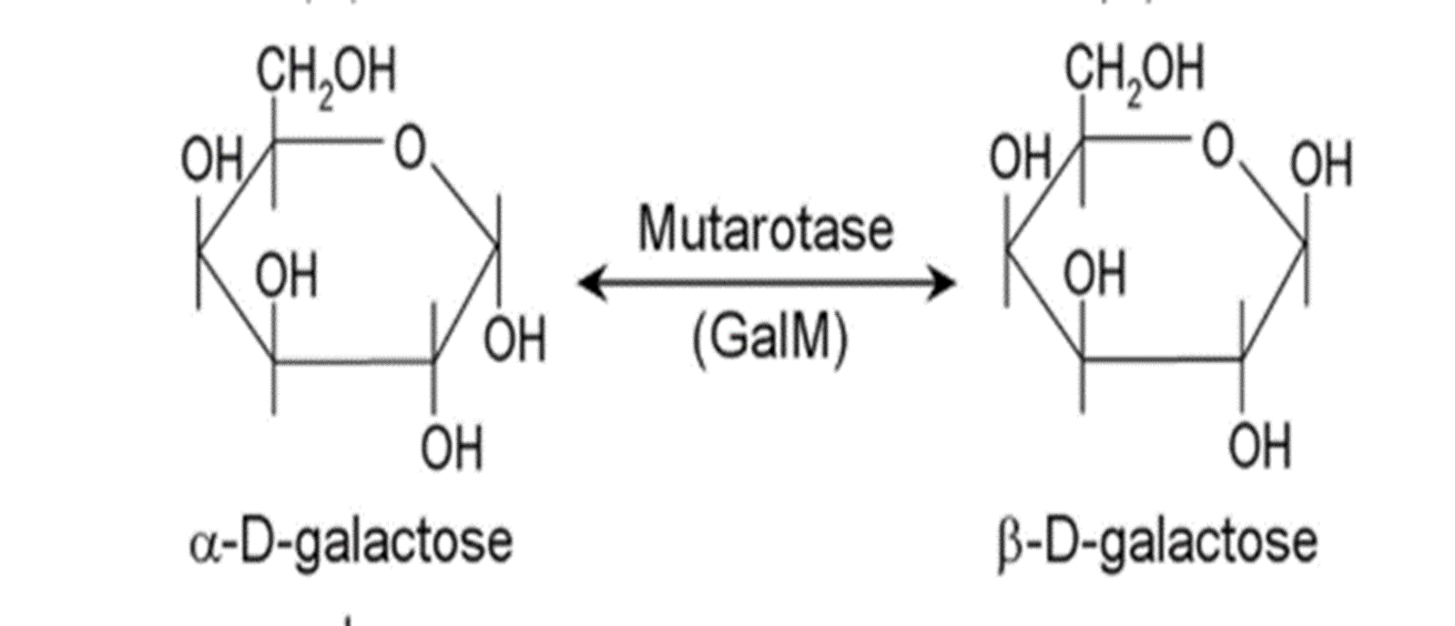
Continuation..

Slide 26
Continuation…
The first reaction of the Leloir pathway is the phosphorylation of α-D-galactose by galactokinase to yield galactose-1-phosphate.
Epimerization of galactose-1-phosphate to glucose-1-phosphate (G-1-P) requires the transfer of UDP from UDP-glucose catalyzed by galactose-1-phosphate uridyltransferase (GALT).The galactose-1-phosphate uridyltransferase catalyzed reaction generates UDP-galactose and glucose-1-phosphate (G-1-P).
The UDP-galactose is epimerized to UDP-glucose by UDP-galactose-4 epimerase (GALE). The UDP portion is exchanged for phosphate generating glucose-1-phosphate which then is converted to glucose-6-phosphate (G-6-P) by phosphoglucosemutase. The glucose-6-phosphate then joins glycolytic pathway where it is metabolised futher to pyruvate.

Slide 27
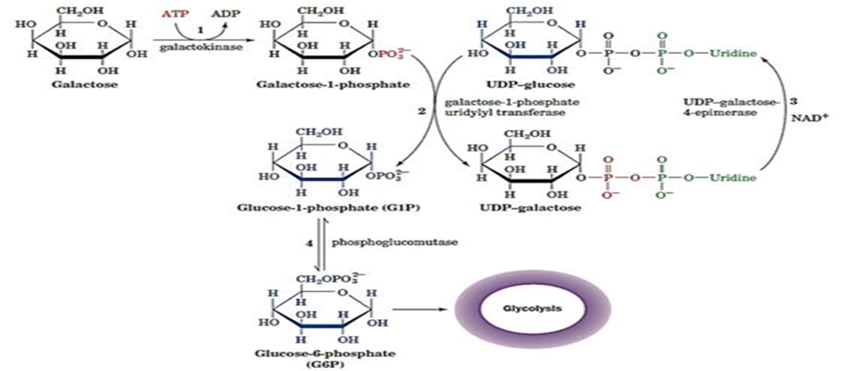
Illustration of Leloir pathway(Galactose pathway)

Slide 28
Metabolic fate of UDP-Galactose
UDP-Gal is an important precursor in the synthesis of glycolipids, such as gangliosides and galactocerebrosides, sphingolipids, mucopolysaccharides and membrane glycoproteins.
In the adult mammary gland, under the influence of prolactin, UDP-Gal can be joined to glucose to give milk sugar(Lactose).
Regulated Reactions-No Regulation
There is no known regulated step in the conversion of galactose to glucose intermediates. The fate of glucose from dietary galactose, toward either glycolysis or glycogenesis, is determined by pathways regulating glucose metabolism in the liver.
Unique Characteristics-UDP-Glucose Intermediate
Although the galactose pathway forms UDP-glucose, there is no net synthesis of this intermediate, since it is recycled. The net output of this pathway is in the conversion of a mole of galactose 1-phosphate to glucose 1-phosphate.

Slide 29
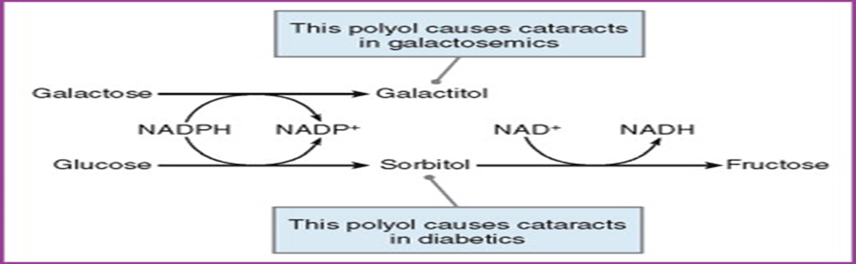
Interface with Other Pathways-Polyol Pathway
Free galactose can be reduced by aldose reductase in the polyol pathway to galactitol (Figure below). The polyol pathway is widely distributed in the body including in the lens, where it contributes to the formation of cataracts in both galactosemia and diabetes.

Slide 30
Continuation..(sorbitol implicating diabetes)
The pathway is implicated in diabetic complications, especially in microvascular damage to the retina, kidney and nerves.
Sorbitol cannot cross cell membranes, and, when it accumulates, it produces osmotic stresses on cells by drawing water into the insulin-independent tissues.
Cells use glucose for energy. This normally occurs by phosphorylation via the enzyme hexokinase.
However, if large amounts of glucose are present (as in diabetes mellitus), hexokinase becomes saturated and the excess glucose enters the polyol pathway when aldose reductase reduces it to sorbitol

Slide 31
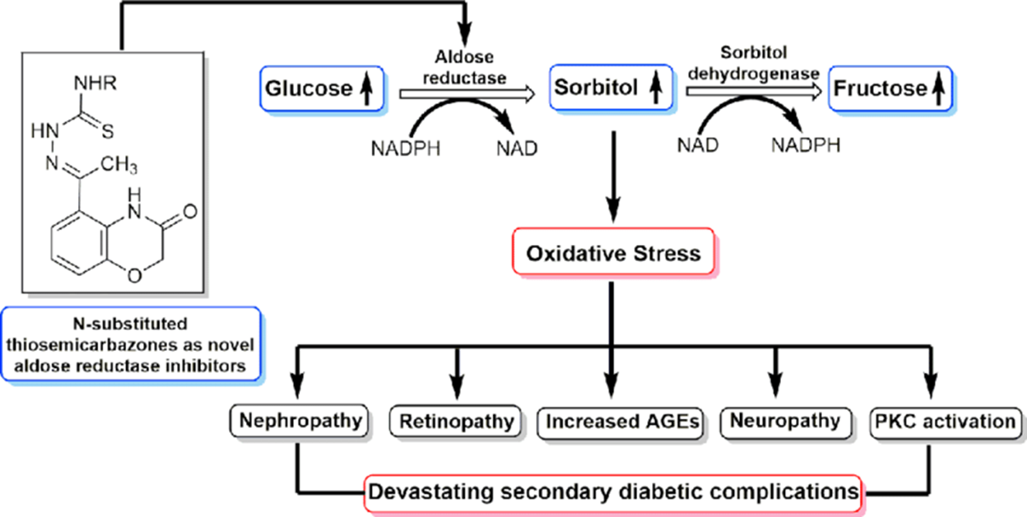
Continuation….

Slide 32
Gluconeogenesis
In mammals, some tissues depend almost completely on glucose for their metabolic energy. e.g. Brain and the nervous system, erythrocytes, testes, renal medulla and embryonic tissues.
Note:
  Supply of glucose stored from stores (Glycogen) is not always sufficient (i.e. brain requires 120g of glucose/day More than half the glucose stored as glycogen in muscle and liver.
  Between meals and prolonged fasts or vigorous exercise, glycogen is depleted.
To maintain blood glucose, glucose is synthesised from non-carbohydrate precursors through Gluconeogenesis.
Gluconeogenic pathway convert pyruvate and related 3 and 4 carbon cpds to glucose.
  In animals important precursors of glucose include: lactate, pyruvate, glycerol
  and some amino acids.
  In microorganisms gluconeogenesis starts from simple organic cpds of 2 or 3 carbons such as: acetate, lactate and propionate.
In Mammals it takes place mainly in the liver and to a lesser extent in renal cortex.

Slide 33
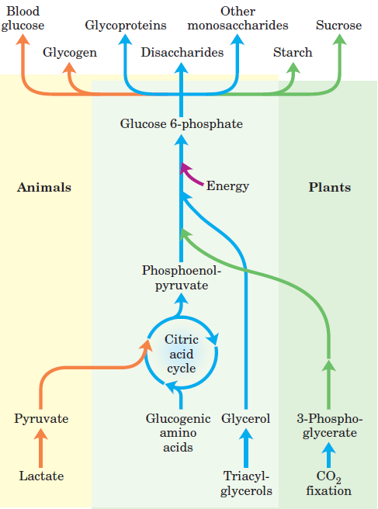
An overview of Gluconeogenesis in Plants and Animals

Slide 34
Reactions of the gluconeogenic pathway
Glycolysis and gluconeogenesis share several steps; seven of the ten enzymatic reactions of gluconeogenesis are the reverse of glycolysis
Three Glycolysis reactions have such a large negative ΔG that they are essentially irreversible.
  Hexokinase (or Glucokinase)
  Phosphofructokinase
  Pyruvate Kinase.
In Gluconeogenesis the three irreversible steps are bypassed by a separate set of enzymes that are irreversible in the direction of glucose synthesis.
Conversion of pyruvate to phosphoenol pyruvate.
Conversion of Fructose 1,6- Bisphosphate to Fructose 6-phosphate.
Conversion of glucose 6-phosphate to glucose.
In animals, both pathways occur largely in the cytosol, necessitating their reciprocal and coordinated regulation.

Slide 35
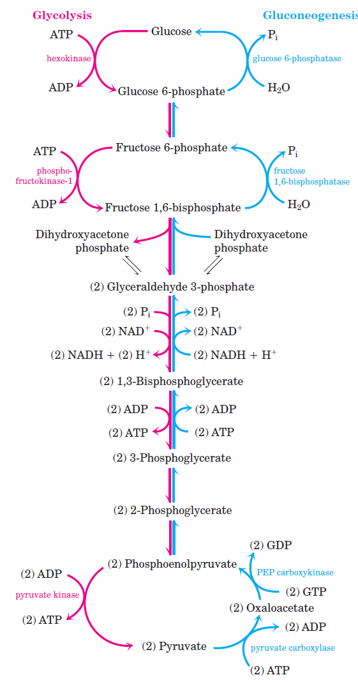
Gluconeogenic pathway

Slide 36
First bypass: Conversion of Pyruvate to phosphoenol pyruvate.
This step requires enzymes in both the Cytosol and Motochondria
Pyruvate is transported to the mitochondria where pyruvate carboxylase converts pyruvate to oxaloacetate.
pyruvate + HCO₃⁻ + ATP → oxaloacetate + ADP + P_{i}
Note: The reaction requires Biotin as a carrier of activated HCO₃⁻
Oxaloacetate formed is transported back to the cytosol where it is converted PEP by phosphoenolpyruvate carboxykinase
oxaloacetate + GTP → PEP + GDP + CO₂

Slide 37
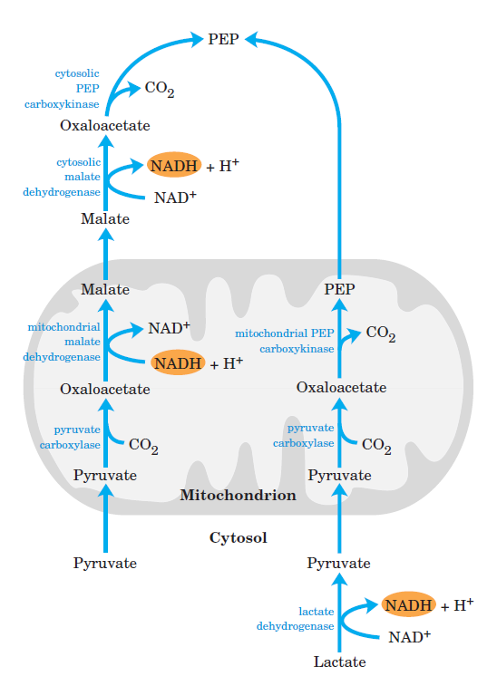
Alternative paths from pyruvate to PEP
Pyruvate is transported to the mitochondria where it is converted to Oxaloacetate.
Oxaloacetae formed is reduced to malate by mitochondrial malate DH at the expense of NADH.
Malate is transported back to the cytosol through a specific transporter where it is reoxidesed to oxaloacetate generating cytosolic NADH.
Oxaloacetate is then converted to PEP by a cytosolic PEP carboxykinase.
OR
Oxaloacetate, can directly be converted to PEP by a mitochondrial isozyme of PEP carboxykinase.

Slide 38
Pyruvate Carboxylase uses biotin as prosthetic group.
Biotin has a 5-C side chain whose terminal carboxyl is in amide linkage to the ε-amino group of an enzyme lysine.
The biotin & lysine side chains form a long swinging arm that allows the biotin ring to swing back & forth between 2 active sites.

Slide 39
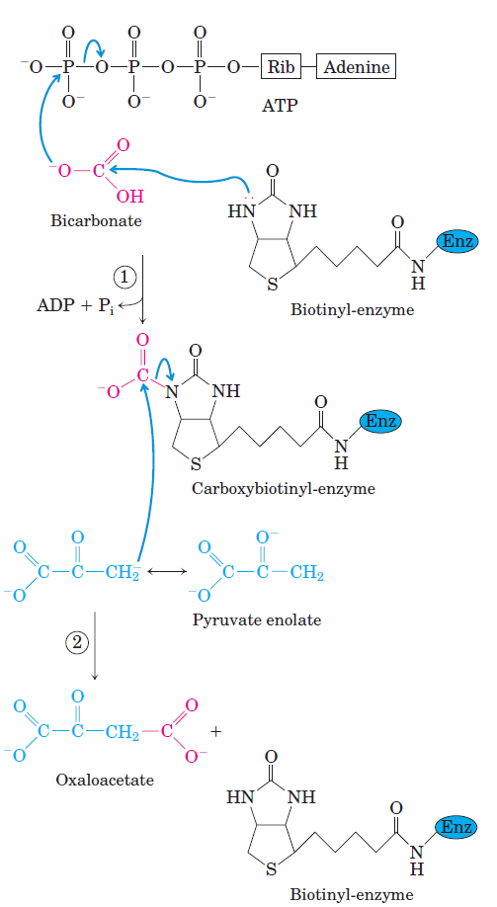
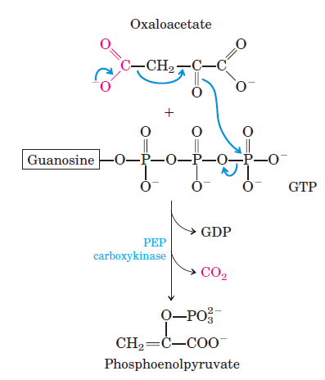
Role of Biotin in the pyruvate carboxylase reaction
The reaction occurs in two steps at different active sites of pyruvate carboxylase enzyme.

Slide 40
Second bypass: Conversion of F 1,6- Bisphosphate to F 6-Phosphate.
This is catalysed by a different enzyme, Mg²⁺- dependent fructose 1,6-bisphosphatase (FBPase-1) which promotes the irreversible hydrolysis of C-1 phosphate.
Phosphofructokinase (Glycolysis) catalyzes:
fructose-6-P + ATP → fructose-1,6-bisP + ADP
Fructose-1,6-bisphosphatase (Gluconeogenesis) catalyzes:
fructose-1,6-bisP + H₂O → fructose-6-P + P_{i}

Slide 41
Third bypass: Conversion of Glc 6- phosphate to glucose.
The reaction is catalysed by glucose 6-phosphatase, without synthesis of ATP, it is a simple hydrolysis of a phosphate ester
This Mg2+ activated enzyme is found on the lumenal side of the ER of Hepatocytes and Renal cells.
Note: Muscle and brain tissues do not have this enzyme thus connot carry out gluconeogenesis.
Hexokinase or Glucokinase (Glycolysis) catalyzes:
glucose + ATP → glucose-6-phosphate + ADP
Glucose-6-Phosphatase (Gluconeogenesis) catalyzes:
glucose-6-phosphate + H₂O → glucose + P_{i}

Slide 42
The source of pyruvate and oxaloacetate for gluconeogenesis during fasting or carbohydrate starvation is mainly amino acid catabolism.
Some amino acids are catabolized to pyruvate, oxaloacetate, or precursors of these.
Muscle proteins may break down to supply amino acids. These are transported to liver where they are deaminated and converted to gluconeogenesis inputs.
Glycerol, derived from hydrolysis of triacylglycerols in fat cells, is also a significant input to gluconeogenesis.

Slide 43
Regulation of Gluconeogenesis
Allosteric control
1. Pyruvate Carboxylase (pyruvate → oxaloactate) is allosterically activated by: acetyl CoA.
[Oxaloacetate] tends to be limiting for Krebs cycle.
2. Fructose 1,6 bisphosphatase:
AMP is its allosteric inhibitor.
When gluconeogenesis is active in liver, oxaloacetate is diverted to form glucose.
Oxaloacetate depletion hinders acetyl CoA entry into Krebs Cycle.
The increase in [acetyl CoA] activates Pyruvate Carboxylase to make oxaloacetate.
Note: Avidin, a protein in egg whites, tightly binds biotin.
Excess consumption of raw eggs can cause nutritional deficiency of biotin.
Hormonal regulation
Insulin decreases the synthesis of key enzymes of gluconeogenesis, thus inhibit gluconeogenesis.
Note: Glycolysis and gluconeogeesis are regulated reciprocally.

Slide 44
Glycolysis & Gluconeogenesis: both spontaneous.
If both pathways were simultaneously active in a cell, it would constitute a "futile cycle" that would waste energy.
Glycolysis:
glucose + 2 NAD⁺ + 2 ADP + 2 P_{i} →
2 pyruvate + 2 NADH + 2 ATP
Gluconeogenesis:
2 pyruvate + 2 NADH + 4 ATP + 2 GTP →
glucose + 2 NAD⁺ + 4 ADP + 2 GDP + 6 P_{i}
Questions:
1. Glycolysis yields how many ~P ? 2
2. Gluconeogenesis expends how many ~P ? 6
3. A futile cycle of both pathways would waste how many
~P per cycle ? 4

Slide 45
To prevent the waste of a futile cycle, Glycolysis & Gluconeogenesis are reciprocally regulated.
Local Control: Includes reciprocal allosteric regulation by adenine nucleotides.
  Phosphofructokinase (Glycolysis) is inhibited by ATP and stimulated by AMP.
  Fructose-1,6-bisphosphatase (Gluconeogenesis) is inhibited by AMP.
The opposite effects of adenine nucleotides on
  Phosphofructokinase (Glycolysis)
  Fructose-1,6-bisphosphatase (Gluconeogenesis)
insures that:
When cellular ATP is high (AMP would then be low), glucose is not degraded to make ATP.
When ATP is low (AMP would then be high), the cell does not expend energy in synthesizing glucose.

Slide 46
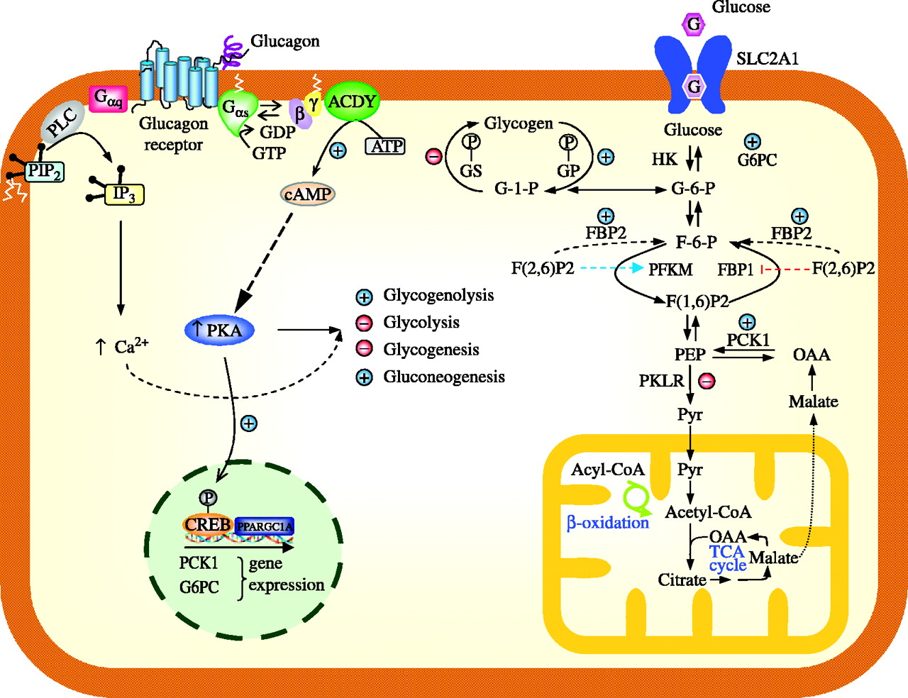
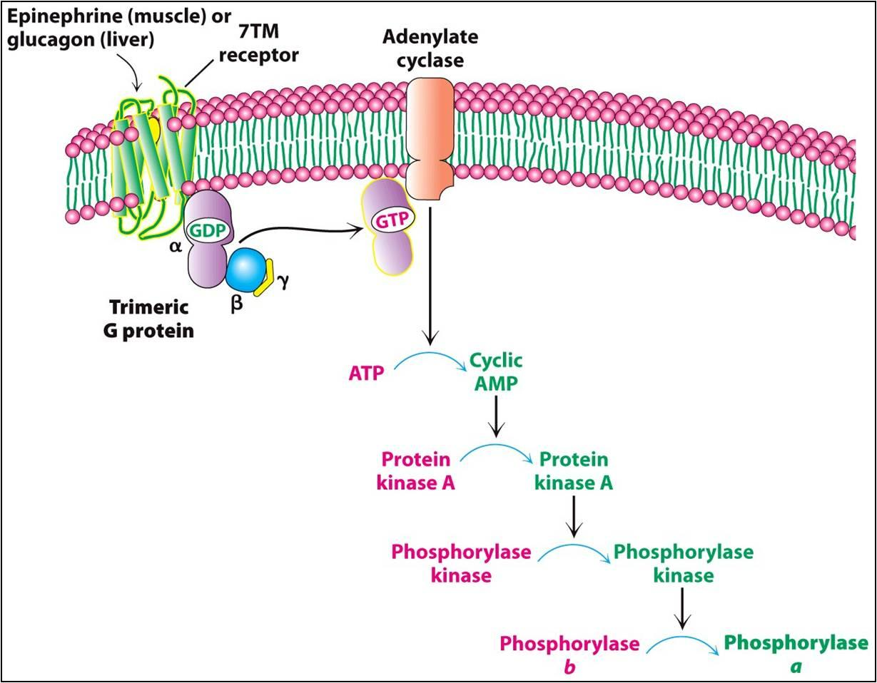
Global Control:includes reciprocal effects of a cyclic AMP cascade, triggered by the hormone glucagon when blood glucose is low.
Activation of other enzymes
Activation of Glycogen phosphorylase

Slide 47
Enzymes relevant to these pathways that are phosphorylated by Protein Kinase A include:
  Pyruvate Kinase, a glycolysis enzyme that is inhibited when phosphorylated.
  CREB (cAMP response element binding protein) which activates, through other factors, transcription of the gene for PEP Carboxykinase, leading to increased gluconeogenesis.
  A bi-functional enzyme (PFK-2) that makes and degrades an allosteric regulator, fructose-2,6-bisphosphate (A potent activator of PFK-1 and an inhibitor of Fructose 1,6 bisphosphatase.

Slide 48
Reciprocal regulation by fructose-2,6-bisphosphate:
  Fructose-2,6-bisphosphate stimulates Glycolysis.
  Fructose-2,6-bisphosphate allosterically activates the Glycolysis enzyme Phosphofructokinase 1.
  Fructose-2,6-bisphosphate also activates transcription of the gene for Glucokinase, the liver variant of Hexokinase that phosphorylates glucose to glucose-6-phosphate, the input to Glycolysis.
  Fructose-2,6-bisphosphate allosterically inhibits the gluconeogenesis enzyme Fructose-1,6-bisphosphatase.

Slide 49
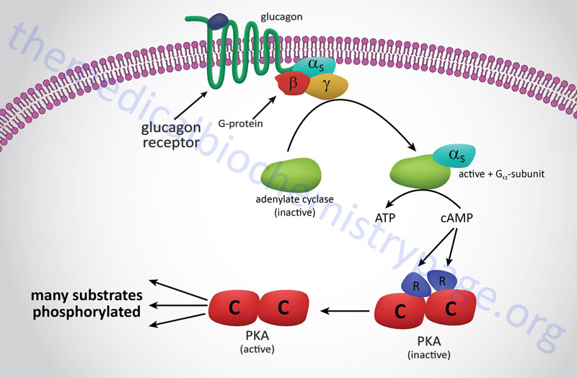
Phosphorylation of enzymes & regulatory proteins in liver by Protein Kinase A (cAMP Dependent Protein Kinase) results in
  inhibition of glycolysis
  stimulation of gluconeogenesis,
making glucose available for release to the blood.

Slide 50
The Cori Cycle
The Cori Cycle operates during exercise.
For a brief burst of ATP utilization, muscle cells utilize ~P stored as phosphocreatine.
Once phosphocreatine is exhausted, ATP is provided mainly by Glycolysis, with the input coming from glycogen breakdown and from glucose uptake from the blood.

Slide 51
Lactate produced from pyruvate passes via the blood to the liver, where it may be converted to glucose.
The glucose may travel back to the muscle to fuel Glycolysis.

Slide 52
The Cori cycle costs 6 ~P in liver for every 2 ~P made available in muscle. The net cost is 4 ~P.
Although costly in ~P bonds, the Cori Cycle allows the organism to accommodate to large fluctuations in energy needs of skeletal muscle between rest and exercise.

Slide 53
The equivalent of the Cori Cycle also operates during cancer.
If blood vessel development does not keep pace with growth of a solid tumor, decreased O₂ concentration within the tumor leads to activation of signal processes that result in a shift to anaerobic metabolism.

Slide 54
Energy dissipation by the Cori Cycle, which expends 6 ~P in liver for every 2 ~P produced via Glycolysis for utilization within the tumor, is thought to contribute to the weight loss that typically occurs in late-stage cancer even when food intake remains normal.

Slide 55
Pentose Phosphate pathway
Also known as:
Pentose shunt
Hexose monophosphate shunt
Phosphogluconate pathway
It occurs in the cytosol.

Slide 56
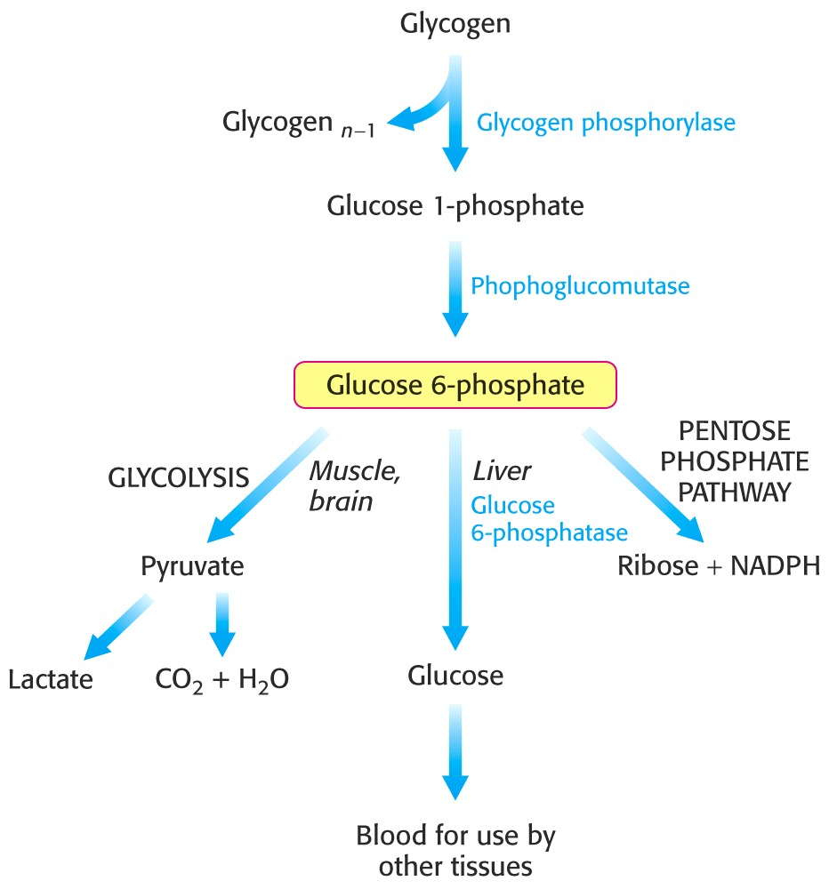
One fate of G6P is the pentose pathway.

Slide 57
What does the pentose phosphate pathway achieve?
The pathway yields reducing potential in the form of NADPH to be used in anabolic reactions requiring electrons.
The pathway yields ribose 5-phosphate.
  Nucleotide biosynthesis leading to:
    DNA
    RNA
    Various cofactors (CoA, FAD, NAD⁺/NADP⁺).

Slide 58
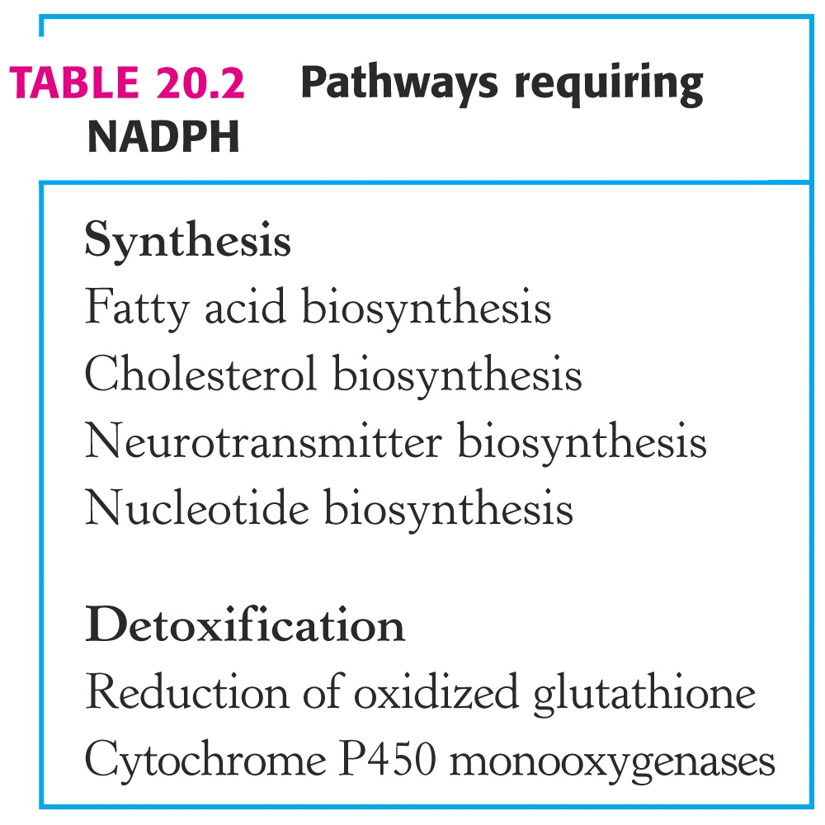

Slide 59
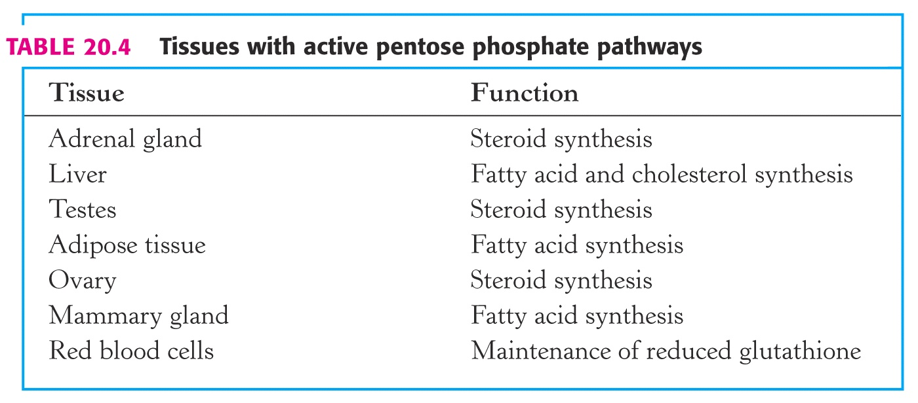
Tissues with active pentose phosphate pathway
Pentose phosphate pathway is especially prominent in tissues actively synthesizing fatty acids and steroids.
These tissues use NADPH to reduce the double bonds and carbonyl groups of intermediates in the synthetic process.
PPP is also prominent in growing and regenerating tissues and in tumors.

Slide 60
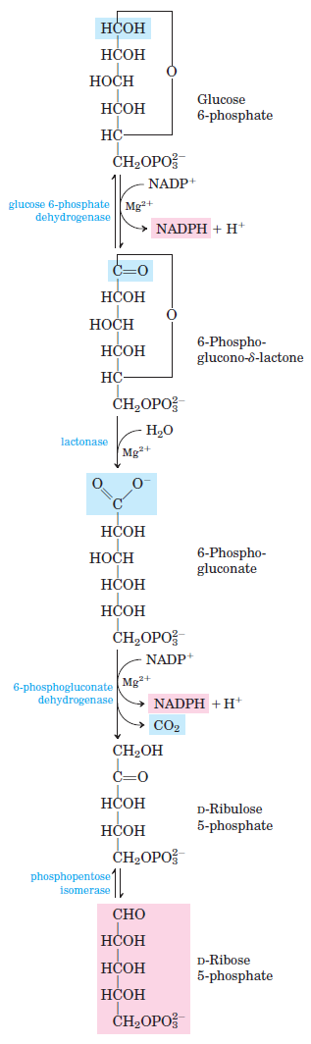
Reactions of the Pentose Phosphate Pathway
The pentose pathway can be divided into two phases:
Oxidative phase.
Non-oxidative phase.
Oxidative reactions of the pentose phosphate pathway
Steps
1. Dehydrogenation of glucose 6-phosphate by glucose 6-phosphate DH
2. The lactone is hydrolysed to the free acid; 6-phosphogluconate by a specific lactonase
3. Dehydrogenation and decarboxylation of 6-phosphogluconate by 6-phosphogluconate dehydrogenase to ribulose 5-phosphate.
4. Phosphopentose isomerase converts ribulose 5-phosphate to its aldolase isomer ribose 5- phosphate.

Slide 61
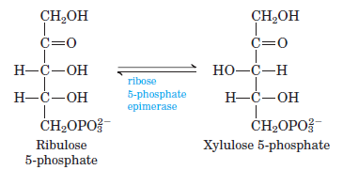
Non-Oxidative reactions of the pentose phosphate pathway
Occurs in tissues that require primarily NADPH.
The pentose phosphates produced in the oxidative phase of the pathway are recycled into glucose 6-phosphate.
Steps
1. In this non-oxidative phase, ribulose 5-phosphate is first epimerized to xylulose 5-phosphate.
In a series of rearrangements of the carbon skeletons six five-carbon sugar phosphates are converted to five six-carbon sugar phosphates, completing the cycle, allowing continued production of NADPH.
Two enzymes unique to the pentose phosphate pathway act in these interconversions of sugars: transketolase and transaldolase.

Slide 62
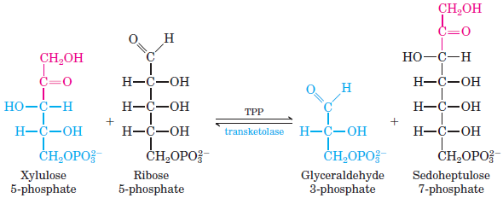
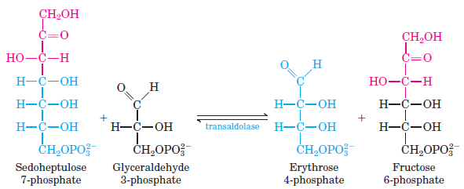
2. Transketolase transfers C-1 and C-2 of xylulose 5-phosphate to ribose 5-phosphate, forming the seven-carbon product sedoheptulose 7-phosphate and glyceraldehyde 3-phosphate.
3. Transaldolase transfers a three-carbon fragment from sedoheptulose 7-phosphate to glyceraldehyde 3-phosphate, forming fructose 6-phosphate and (the tetrose) erythrose 4-phosphate.

Slide 63
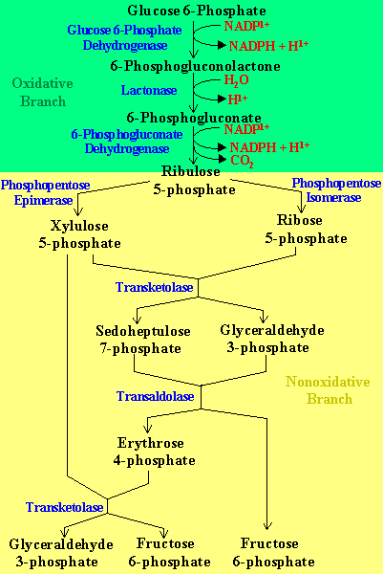
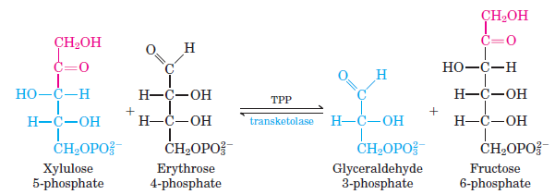
4. transketolase acts again, forming fructose 6-phosphate and glyceraldehyde 3-phosphate from erythrose 4-phosphate and xylulose 5-phosphate .
Note:
The first two steps in the oxidative pentose phosphate pathway are essentially irreversible in in the cell.
The reactions of the non-oxidative part are however readily reversible and thus provide a means of converting hexose phosphates to pentose phosphates.

Slide 64
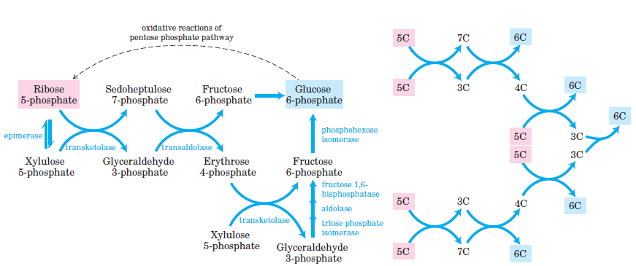
Two molecules of glyceraldehyde 3-phosphate formed by two iterations of these reactions can be converted to a molecule of fructose 1,6-bisphosphate as in gluconeogenesis.
In a complete cycle: six pentose phosphates are converted to five hexose phosphates.

Slide 65
Regulation of the Pentose Pathway
Oxidative Phase
Glucose 6-phosphate DH is the regulatory enzyme.
NADPH is a potent competitive inhibitor of the enzyme.
Usually when the ratio NADPH/NADP⁺ is high so the enzyme is inhibited.
But, with increased demand for NADPH, the ratio decreases and enzyme activity is stimulated.

Slide 66
Non-oxidative Phase
The reactions of the non-oxidative portion of the pentose pathway are readily reversible.
The concentrations of the products and reactants can shift depending on the metabolic needs of a particular cell or tissue.

Slide 67
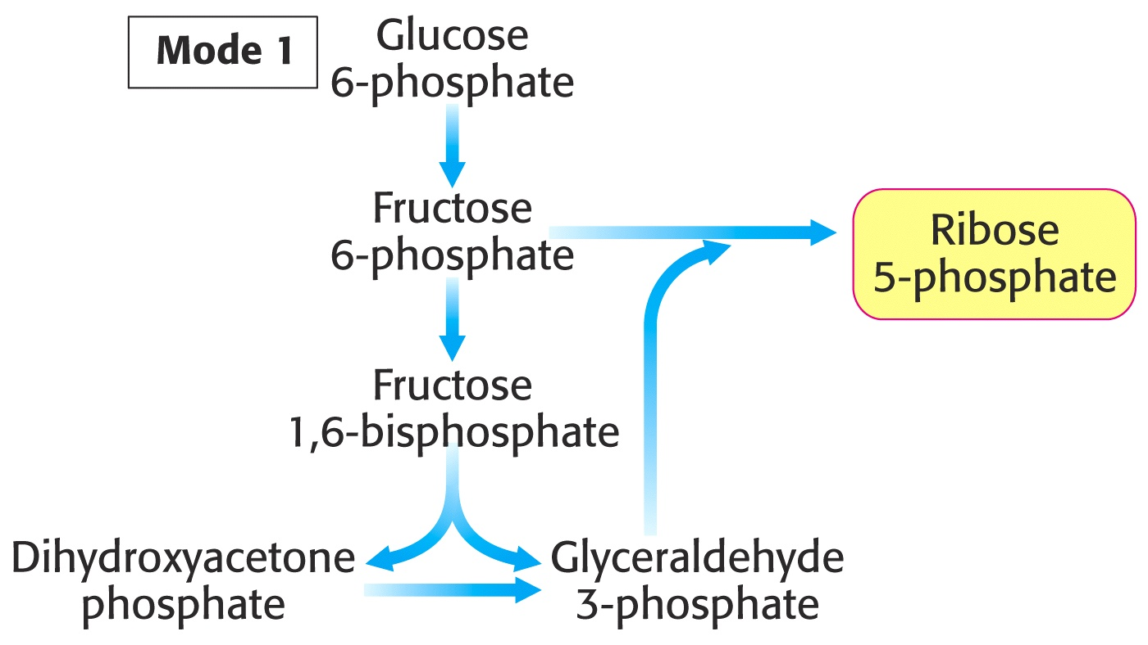
Different scenarios under which the Pentose phosphate pathway is controlled.
Rapidly dividing cells require more ribose 5- phosphate than NADPH.

Slide 68
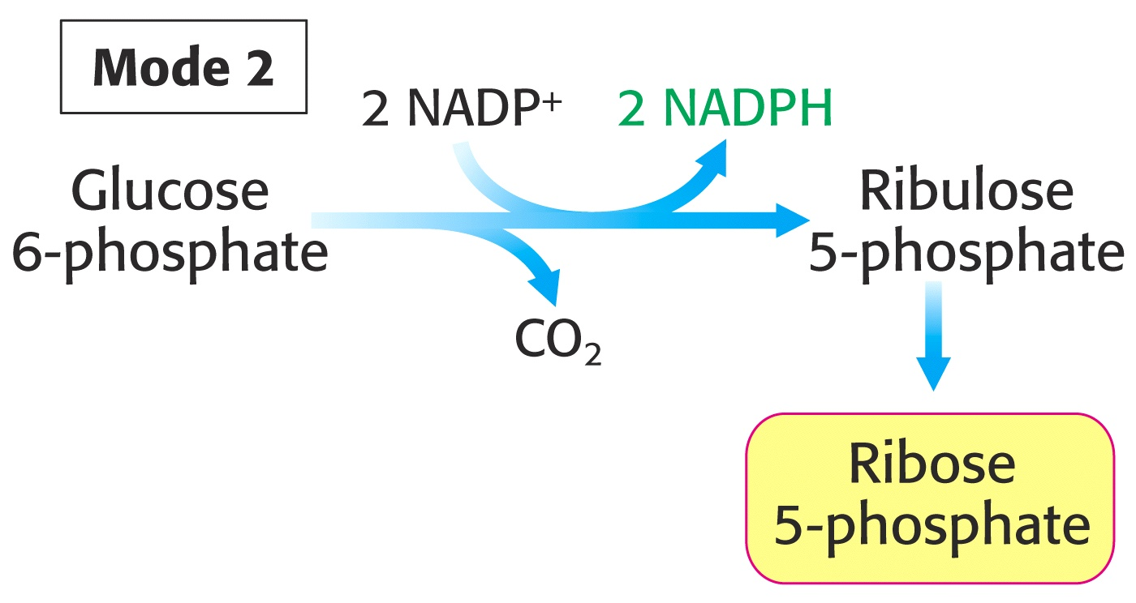
2. The need for NADPH and ribose 5-phosphate is balanced.

Slide 69
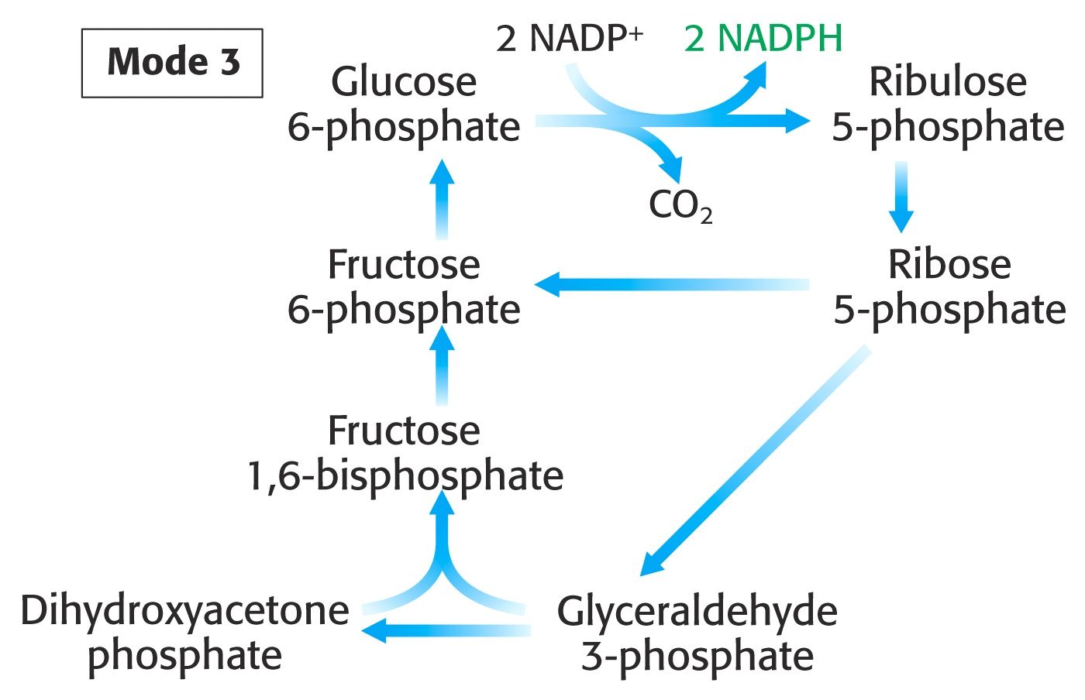
3. More NADPH is needed than ribose 5-phosphate; Fatty acid synthesis in adipose cells.

Slide 70
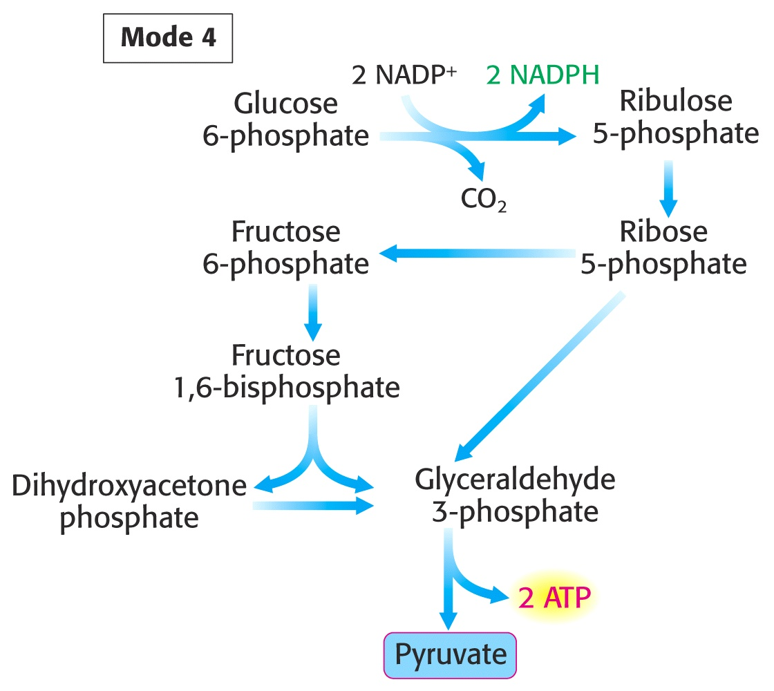
4. The cell needs both NADPH and ATP

Slide 71
Biological importance of HMP shunt
1. NADPH produced in the shunt is used for biosynthesis of several important compounds in various organs.
(a) In the liver, NADPH is used for fatty acid synthesis, cholesterol synthesis, bile acid synthesis, glutamate synthesis and cytochrome P450-hydroxylase system.
(b) In the adrenal cortex and gonads, NADPH is used for cholesterol and hormone synthesis.
(c) In the adipose tissue, NADPH is used for fatty acid synthesis.
(d) NADPH is used for formation of deoxy ribonucleotides and pyrimidine nucleotides.
2. In RBC, NADPH produced is used for the formation of reduced glutathione (GHS)from oxidized glutathione (GSSG), catalyzed by Glutathione reductase. Reduced glutathione is required for removal of H₂O₂ in RBCs by the enzyme glutathione peroxidase for maintenance of erythrocyte proteins.
What is glutathione?
Why is it important?
How is it related to NADPH?

Slide 72
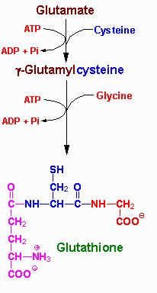
What is glutathione?
Glutathione is a tripeptide composed of glutamate, cystein, glycine.
Reduced glutathione (GSH) maintains the normal reduced state of the cell.
GSH

Slide 73
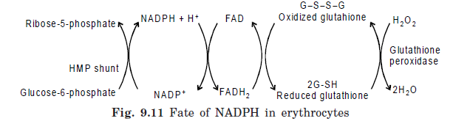
The sulfhydryl of GSH is used to reduce peroxides (ROS) formed during oxygen transport.
  Reactive oxygen species (ROS) damage macromolecules (DNA, RNA, and protein) and ultimately lead to cell death.
The resulting oxidized form of GSH, two molecules of glutathione are linked by a disulfide bridge (GSSG).
Why is it important?

Slide 74
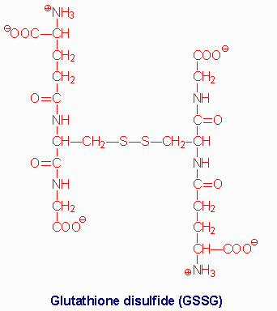
How is it related to NADPH?
The enzyme glutathione reductase uses NADPH as a cofactor to reduce GSSG back to two moles of GSH. Thus, the pentose pathway is linked to the supply of adequate amounts of GSH.

Slide 75
Biological importance of HMP shunt cont……
3. In neutrophils, NADPH is required for the formation of superoxide by NADPH oxidase.
Respiratory burst of neutrophils during phagocytosis involves superoxide formation.
4. Pentoses produced in this pathway are used for nucleic acid synthesis and nucleotide coenzymes like NAD+, FAD and FMN synthesis
5. Non-oxidative phase of the pathway converts pentoses of endogenous or dietary nucleic acids into intermediates of glycolysis where they are, further oxidized to generate energy.

Slide 76
Medical implications of HMP shunt
1. Glucose-6-phosphate dehydrogenase deficiency
G6PD deficiency is an inheritable X-linked recessive disorder.
Approximately 10-14% of the male African American population is affected.
Individules with G6PD deficiency can not produce sufficient GSH to cope with the ROS.
People with the disorder are not normally anemic and display no evidence of the disease until the red cells are exposed to an oxidant or stress.
i.e. The ingestion of oxidative agents that generate peroxides or reactive oxygen species (ROS).
  Antimalarials - pamaquine
  purine glycoside from fava beans.
  The condition is often clinically seen as black urine under certain conditions.

Slide 77
Drugs that can precipitate this reaction:
antimalarial agents
sulfonamides (antibiotic)
aspirin
nonsteroidal antiinflammatory drugs (NSAIDs)
nitrofurantoin
quinidine
quinine
exposure to certain chemicals - mothballs

Slide 78
Medical implications of HMP shunt cont…
2. Wernicke-korsakoff encephalopathy
It is due to defective trasketolase genes.
Transketolase of affected individuals has lower affinity for TPP.
The characteristic symptoms are abnormal walking and standing, memory loss and partial paralysis.
The disease manifests only when there is thiamine deficiency.
The syndrome is more common among alcoholics than in the general population.

Slide 79
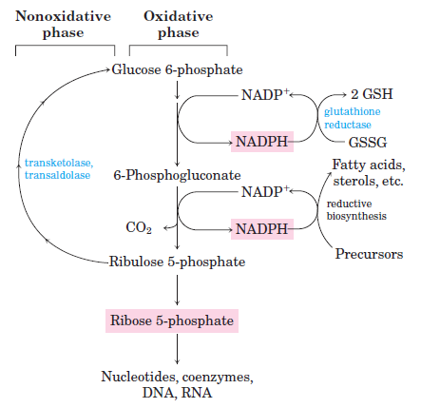
Summary of the Pentose Phosphate Pathway

Slide 80
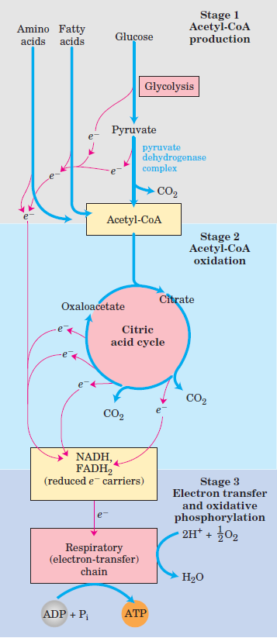
The Citric Acid Cycle
Cellular Respiration:
Occurs in three stages;
1. Oxidation of organic fuel molecules—glucose, fatty acids, and some amino acids—
to yield two-carbon fragments in the form of the acetyl group of acetyl-coenzyme A (acetyl-CoA).
2. The acetyl groups are fed into the citric acid
cycle, which enzymatically oxidizes them to CO₂; conserving energy in form of reduced electron
carriers NADH and FADH₂.
3. Oxidation of NADH and FADH₂ and transfer of
electrons to O₂—the final electron acceptor—via a chain of electron-carrying molecules known as the respiratory chain; Energy is conserved in the form of ATP (oxidative phosphorylation)

Slide 81
Enzymatic conversion of Pyruvate to acetyl CoA
The fate of pyruvate produced during glycolysis and oxidation of other biofuels depends on the amount of energy in the tissues.
If tissues have adequate energy pyruvate is oxidized through gluconeonegenesis to generate glucose which can be converted glycogen for storage.
However, when the energy is low pyruvate is preferentially oxidized to CO₂ and H₂O in the TCA cycle, with generation of 15 molecules ATP per pyruvate.
The enzymatic activities of the TCA cycle (and of oxidative phosphorylation) are located in the mitochondrion.
When transported into the mitochondrion, pyruvate encounters two principal metabolizing enzymes: pyruvate carboxylase (a gluconeogenic enzyme) and pyruvate dehydrogenase (PDH), the first enzyme of the PDH complex.
The activities of these two enzymes depend on the acylation state state of Coenzyme A (CoA).

Slide 82
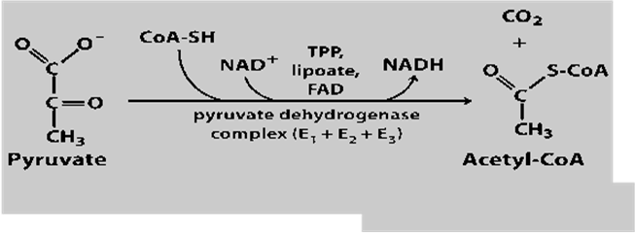
CONT’
In the presence of CoA, NAD, FAD and TPP pyruvate is converted to acetyl CoA with release CO₂.
The acetyl CoA formed enters the TCA cycle as a substrate for energy generation.
This reaction is illustrated in the reaction here below.

Slide 83
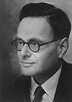
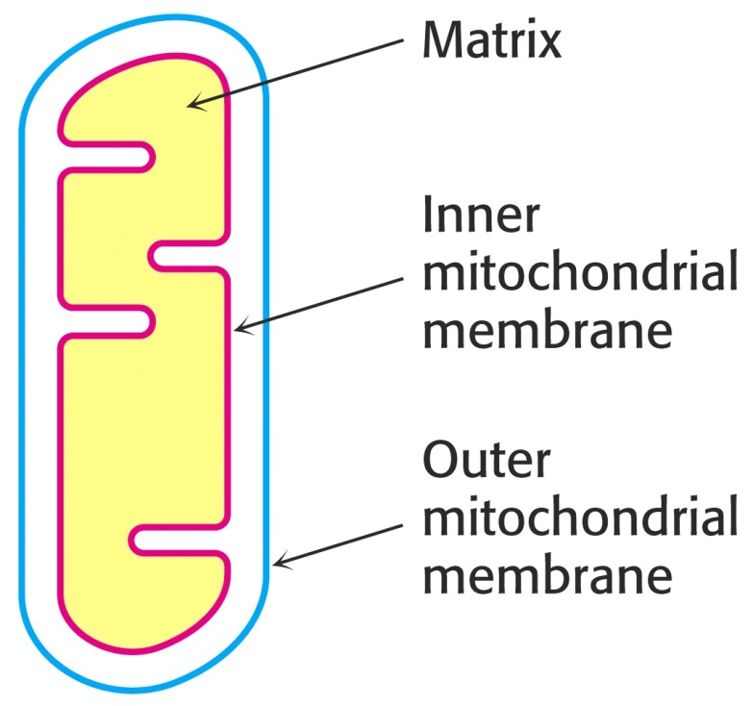
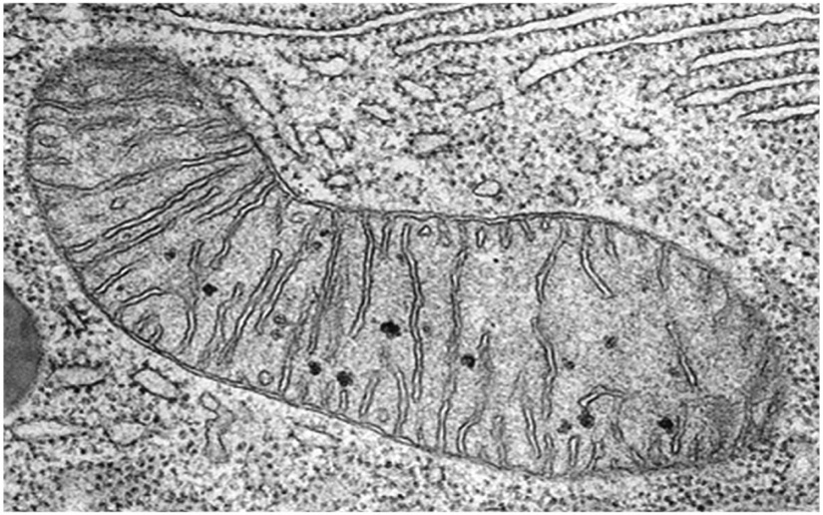
Citric Acid Cycle
Names:
The Citric Acid Cycle
Tricarboxylic Acid Cycle
Krebs Cycle
Hans Adolf Krebs. Biochemist; born in Germany. Worked in Britain. His discovery in 1937 of the ‘Krebs cycle’ of chemical reactions was critical to the understanding of cell metabolism and earned him the 1953 Nobel Prize for Physiology or Medicine.
In eukaryotes the reactions of the citric acid cycle take place inside mitochondria

Slide 84

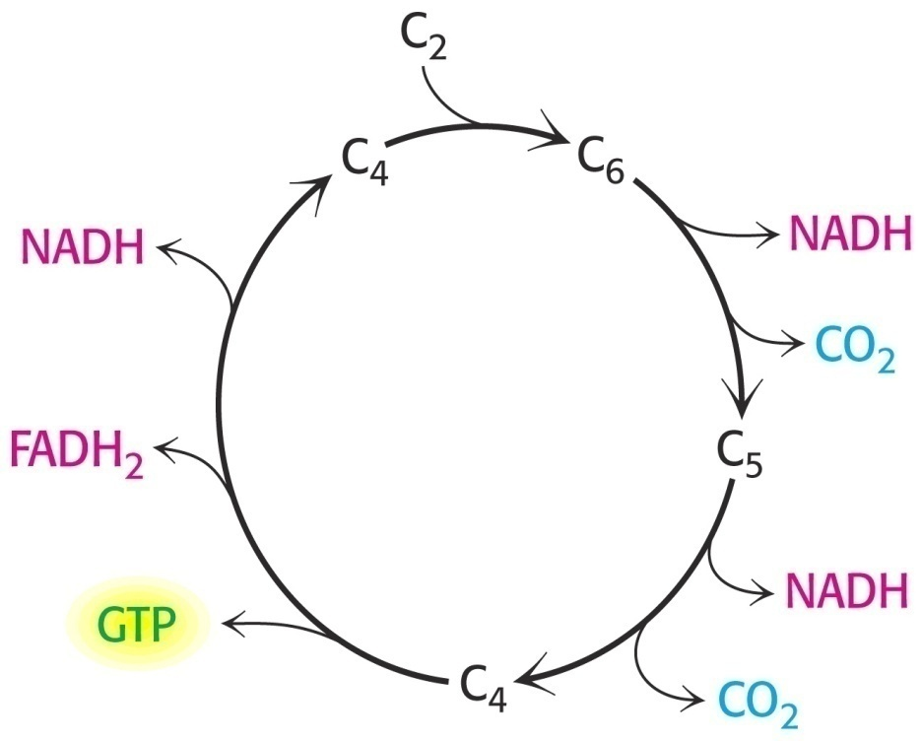
An Overview of the Citric Acid Cycle
A four-carbon oxaloacetate condenses with a two-carbon acetyl unit to yield a six-carbon citrate.
An isomer of citrate is oxidatively decarboxylated to five-carbon α-ketoglutarate.
α-ketoglutarate is oxidatively decarboxylated to yield a four-carbon succinate.
Oxaloacetate is then regenerated from succinate.
Two carbon atoms (acetyl CoA) enter the cycle and two carbon atoms leave the cycle in the form of two molecules of carbon dioxide.
Three hydride ions (six electrons) are transferred to three molecules of NAD⁺, one pair of hydrogen atoms (two electrons) is transferred to one molecule of FAD.
The function of the citric acid cycle is the harvesting of high-energy electrons from acetyl CoA.

Slide 85
Functions of the Citric Acid Cycle
Integration of metabolism. The citric acid cycle is amphibolic (both catabolic and anabolic).
The cycle is involved in the aerobic catabolism of carbohydrates, lipids and amino acids.
Intermediates of the cycle are starting points for many anabolic reactions.
Yields energy in the form of GTP (ATP).
Yields reducing power in the form of NADH₂ and FADH₂.

Slide 86
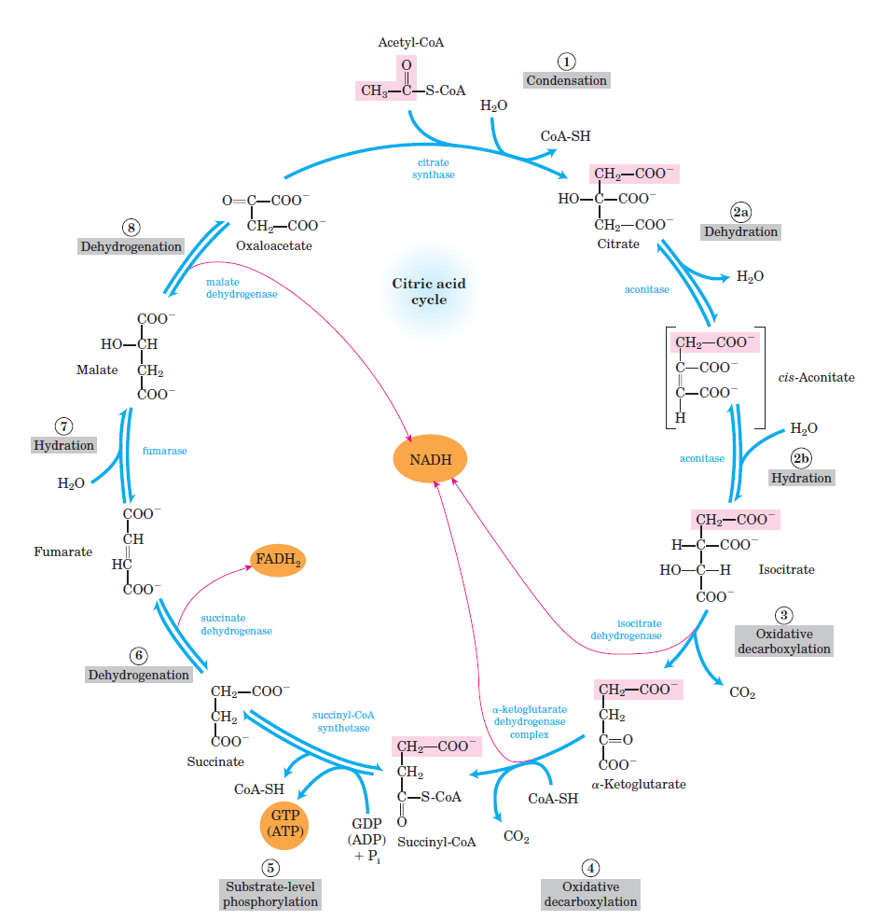
Reactions of the Citric acid cycle

Slide 87
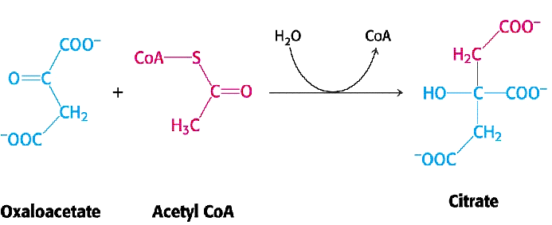
1. Citrate Synthase
Citrate formed from acetyl CoA and oxaloacetate
Only cycle reaction with C-C bond formation
Addition of C₂ unit (acetyl) to the keto double bond of C₄ acid, oxaloacetate, to produce C₆ compound, citrate
citrate synthase

Slide 88
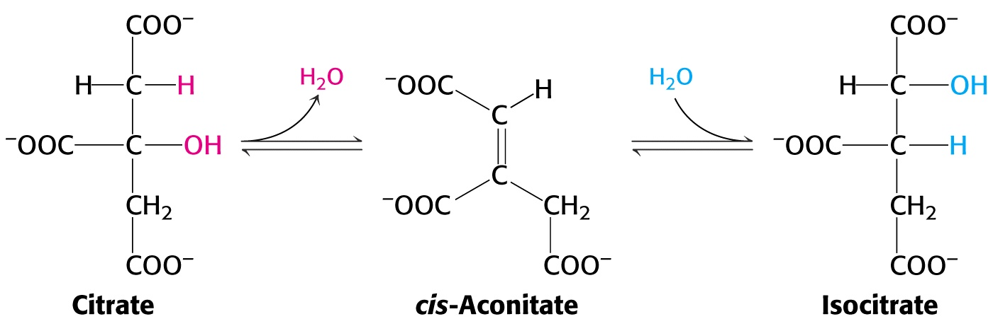
2. Aconitase
Elimination of H₂O from citrate to form C=C bond of cis-aconitate.
Stereospecific addition of H₂O to cis-aconitate to form isocitrate.
aconitase
aconitase

Slide 89
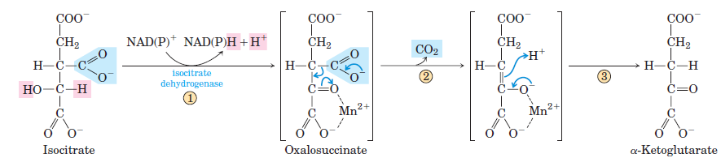
3. Isocitrate Dehydrogenase
Oxidative decarboxylation of isocitrate to
a-ketoglutarate (a metabolically irreversible reaction)
One of four oxidation-reduction reactions of the cycle
Hydride ion from the C-2 of isocitrate is transferred to NAD⁺ to form NADH
Oxalosuccinate is decarboxylated to a-ketoglutarate

Slide 90

4. The α-Ketoglutarate Dehydrogenase Complex
Similar to pyruvate dehydrogenase complex
Same coenzymes, identical mechanisms
E₁ - a-ketoglutarate dehydrogenase (with TPP) E₂ – dihydrolipoyl succinyltransferase (with flexible lipoamide prosthetic group) E₃ - dihydrolipoyl dehydrogenase (with FAD)
α-ketoglutarate dehydrogenase

Slide 91

5. Succinyl-CoA Synthetase
Free energy in thioester bond of succinyl CoA is conserved as GTP or ATP in higher animals (or ATP in plants, some bacteria)
Substrate level phosphorylation reaction
+
HS-
Succinyl-CoA Synthetase
GTP + ADP GDP + ATP

Slide 92

6. The Succinate Dehydrogenase Complex
Complex of several polypeptides, an FAD prosthetic group and iron-sulfur clusters
Embedded in the inner mitochondrial membrane
Electrons are transferred from succinate to FAD and then to ubiquinone (Q) in electron transport chain
Dehydrogenation is stereospecific; only the trans isomer is formed
Succinate Dehydrogenase

Slide 93

7. Fumarase
Stereospecific trans addition of water to the double bond of fumarate to form L-malate
Only the L isomer of malate is formed
Fumarase

Slide 94

8. Malate Dehydrogenase
Malate is oxidized to form oxaloacetate.
Malate Dehydrogenase

Slide 95
Regulation of the Citric Acid Cycle
Pathway controlled by:
(1) Allosteric modulators
(2) Covalent modification of cycle enzymes
(3) Supply of acetyl CoA (pyruvate dehydrogenase complex)
Three enzymes have regulatory properties
citrate synthase (is allosterically inhibited by NADH, ATP, succinyl CoA, citrate – feedback inhibition)
isocitrate dehydrogenase (allosteric effectors: (+) ADP; (-) NADH, ATP. Bacterial ICDH can be covalently modified by kinase/phosphatase)
α-ketoglutarate dehydrogenase complex (inhibition by ATP, succinyl CoA and NADH

Slide 96

Regulation of the citric acid cycle
-
NADH, ATP, succinyl CoA, citrate

Slide 97

Krebs Cycle is a Source of Biosynthetic Precursors

Slide 98

Stoichiometry of the Citric Acid Cycle
Two carbon atoms enter the cycle in the form of acetyl CoA.
Two carbon atoms leave the cycle in the form of CO₂ .
Four pairs of hydrogen atoms leave the cycle in four oxidation reactions (three molecules of NAD⁺ one molecule of FAD are reduced).
One molecule of GTP,
is formed.
9 ATP (3 ATP per NADH, and 2 ATP per FADH₂) are produced during oxidative phosphorylation.
1 ATP is directly formed in the citric acid cycle.
1 acetyl CoA generates approximately 12 molecules of ATP.

Slide 99
Summary of Krebs Cycle
How many energy-producing molecules do we have per 1 glucose molecule?
Glycolysis: 2 ATP, 2 NADH
Intermediate step: Pyruvate oxidation
1 NADH x2= 2 NADH
Krebs Cycle: 3 NADHx2= 6 NADH
1 ATPx2= 2 ATP
1 FADH2x2= 2 FADH2
Total: 4 ATP, 10 NADH, 2 FADH2 --> forms 38 ATP in the electron transport chain

Slide 100
The role of vitamins in TCA cycle
Vitamins, mainly of the B-group play important roles in TCA cycle. Four of the B vitamins that are essential in the TCA cycle and hence energy-yielding metabolism are:
Riboflavin in the form of flavin adenine dinucleotide (FAD), it is a co-factor for succinate dehydrogenase.
Niacin in the form the form of adenine dinucleotide is the electron acceptor for isocitrate dehydrogenase, α-ketoglutarate dehydrogenase, and malate dehydrogenase.
Thiamine (Vitamin B1) as thiamine diphosphate is the co-enzyme for decarboxylation in the α-ketoglutarate dehydrogenase reaction.
Pantothenic acid is a part of coenzyme A, the co-factor attached to "active" carboxylic acid residues such as acetyl-CoA and succinyl-CoA.

